Slide 1
Jukebox project
By: Mentor:
Kriti sharma Hemalatha Maam
Sandhya Maam

Slide 2
AGENDA
Introduction​
Primary goals
​Database Design
Implementation
​Summary​

Slide 3
Introduction
Jukebox is a device which was used in the 1970’s and 80’s . Its main purpose was to play songs selected by the user .In the project we are trying to make a jukebox from scratch.

Slide 4
PRIMARY GOALS

Slide 5
To design a database
To implement the database
To code
To execute

Slide 6
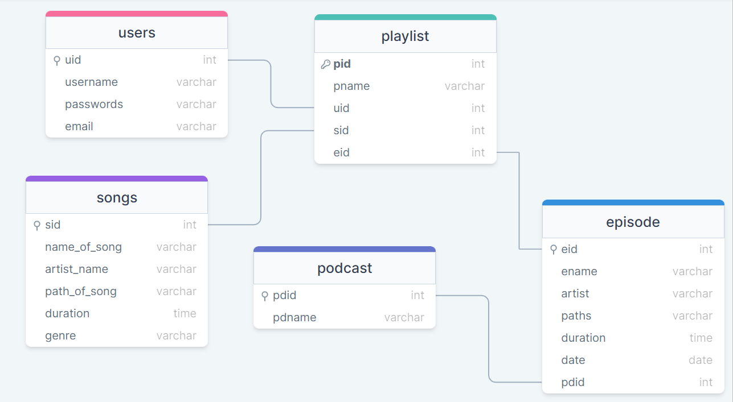
Database design

Slide 7
implementation

Slide 8
Once the database is created , now we have to start the implementation of the database . We have divided the implementation process into multiple steps ,like we have to authenticate the users and have sign up of the users and include functions for playing, displaying songs and podcast .

Slide 9
summary
When we complete the execution of the now our jukebox is ready . We can play songs ,pause them, restart them etc

Slide 10
Thank you

